Slide 1

Builder
An Object Creational Pattern

Slide 2
Intent / Applicability
Separate the construction of a complex object from its representation so that the same construction process can create different representations
Use the Builder pattern when:
  the algorithm for creating a complex object should be independent of the parts that make up the object and how they are assembled
  the construction process must allow different representations for the object that is constructed

Slide 3
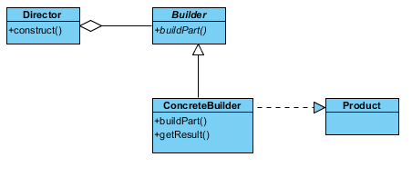
UML Structure

Slide 4
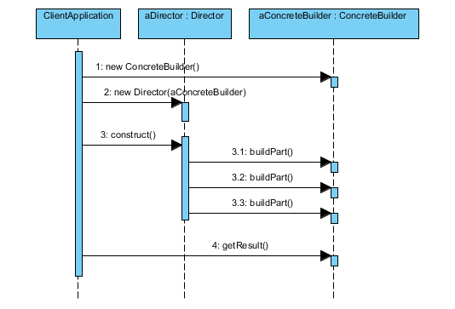
Sequence Diagram

Slide 5
Check list
1. Decide if a common input and many possible representations (or outputs) is the problem at hand.
2. Encapsulate the parsing of the common input in a Reader class.
3. Design a standard protocol for creating all possible output representations. Capture the steps of this protocol in a Builder interface.
4. Define a Builder derived class for each target representation.
5. The client creates a Reader object and a Builder object, and registers the latter with the former.
6. The client asks the Reader to "construct".
7. The client asks the Builder to return the result.

Slide 6

Example: building different types of Pizzas
Waiter: director
PizzaBuilder : abstract builder
Pizza: product
Sample concrete builders:
HawaiianPizzaBuilder
SpicyPizzaBuilder
Example

Slide 7
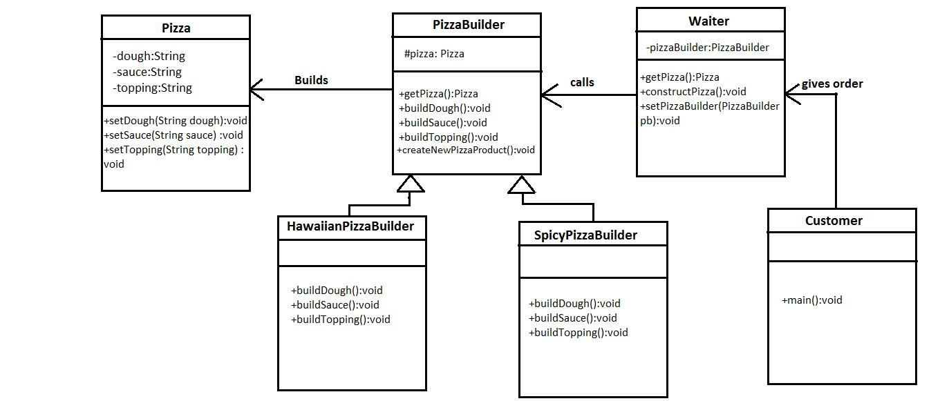

Slide 8
Director
class Waiter {
private PizzaBuilder pizzaBuilder;
public void setPizzaBuilder(PizzaBuilder pb) {
pizzaBuilder = pb;
}
public Pizza getPizza() {
return pizzaBuilder.getPizza();
}
public void constructPizza() {
pizzaBuilder.createNewPizzaProduct();
pizzaBuilder.buildDough();
pizzaBuilder.buildSauce();
pizzaBuilder.buildTopping();
}
}

Slide 9
AbstractBuilder
abstract class PizzaBuilder {
protected Pizza pizza;
public Pizza getPizza() {
return pizza;
}
public void createNewPizzaProduct() {
pizza = new Pizza();
}
public abstract void buildDough();
public abstract void buildSauce();
public abstract void buildTopping();
}

Slide 10
Product
class Pizza {
private String dough = "";
private String sauce = "";
private String topping = "";
public void setDough(String dough) {
this.dough = dough;
}
public void setSauce(String sauce) {
this.sauce = sauce;
}
public void setTopping(String topping) {
this.topping = topping;
}
}

Slide 11
ConcreteBuilder 1
class HawaiianPizzaBuilder extends PizzaBuilder {
public void buildDough() {
pizza.setDough("cross");
}
public void buildSauce() {
pizza.setSauce("mild");
}
public void buildTopping() {
pizza.setTopping("ham+pineapple");
}
}

Slide 12
ConcreteBuilder 2
class SpicyPizzaBuilder extends PizzaBuilder {
public void buildDough() {
pizza.setDough("pan baked");
}
public void buildSauce() {
pizza.setSauce("hot");
}
public void buildTopping() {
pizza.setTopping("pepperoni+salami");
}
}

Slide 13
Client Application
public class PizzaBuilderDemo {
public static void main(String[] args) {
Waiter waiter = new Waiter();
PizzaBuilder hawaiianPizzabuilder = new HawaiianPizzaBuilder();
PizzaBuilder spicyPizzaBuilder = new SpicyPizzaBuilder();
waiter.setPizzaBuilder( hawaiianPizzabuilder );
waiter.constructPizza();
Pizza pizza = waiter.getPizza();
}
}

Slide 14
Builder: Advantages / Disadvantages
Advantages:
  Allows you to vary a product’s internal representation
  Encapsulates code for construction and representation
  Provides control over steps of construction process
Disadvantages:
  Requires creating a separate ConcreteBuilder for each different type of Product

